Slide 1
Ind. 4.03 – Acquire a foundational knowledge of product/service management to understand its scope and nature.
ENTREPRENEURSHIP I

Slide 2
So What…..
Think about the last product you purchased…. Have you ever thought about who’s responsible for those products and what their job duties entail?
Managing products & services effectively is vital to the success of any business! Products just don’t appear on the market overnight…
  Chick-fil-A spent 6 years developing a chicken sandwich that costs less than $4
  The Polio vaccine took over 10 years to develop
  Google took over 3 years to develop
  Those examples are just the beginning of the products life, products must be managed throughout their life!

Slide 3
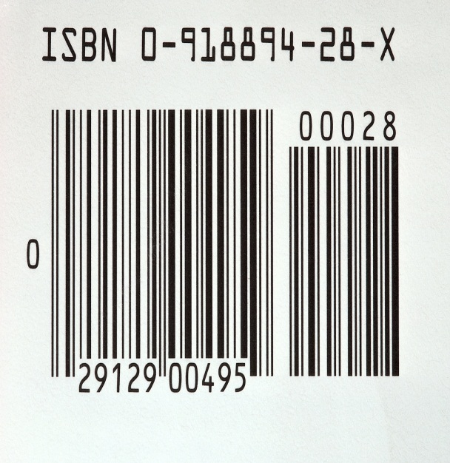

Product/Service Management
Product/service management is a marketing function that involves obtaining, developing, maintaining, and improving a product or service mix in response to market opportunities.

Slide 4

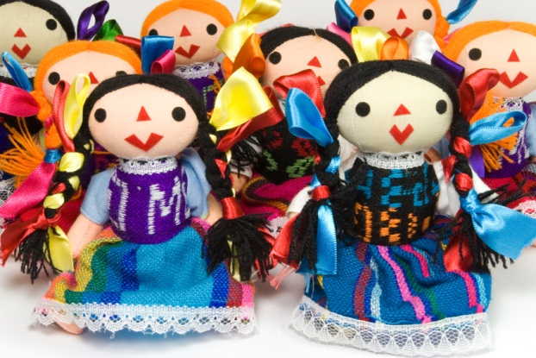
Products
Products can be either a good or a service…..
Goods are tangible objects that can be manufactured & produced for resale, along with its associated benefits.

Slide 5


Products
Products can be either a good or a service…..
Services are intangible activities performed by other people in exchange for payment along, along with its associated benefits.
Two types :
  Product-related: the service is attached to some sort of tangible good (ie. Cell phone & service)
  Pure: the service is not attached to any tangible good
    The service itself is the business’s primary product (i.e banks)

Slide 6
Every business participates in product/service management, whether its employees realize it or not!
In a big company, an entire product/service management department may exist, but even in a small business, the owner or manager is constantly making decisions about what to offer to customers in the product/service mix, throughout the products’ life cycle.
Product/service management involves many activities, such as:
  Discovering new-product opportunities
  Developing marketing plans and strategies for products
  Coordinating the product mix
  Sustaining successful products as long as possible
  Reassessing products that are not meeting expectations
  Eliminating products that have become liabilities

Slide 7





Factors that affect Product/Service Management
Customer needs and wants
Company goals and strategies
Costs and available resources
Competition
The product itself
Government regulations
Stage in the product life cycle (introduction, growth, maturity, and decline)
Business and economic trends

Slide 8
Benefits of Successful Product/Service Management
Improved sales and profits
Improved market share and competitiveness
New customers
Less exposure to financial risk

Slide 9


Role of Product/Service Management in Marketing
Positioning – the strategy in which a business creates a certain image or impression of a product in the mind of the customer
Improves Success
Gives the product an image
  A corporate brand is all of the combined impressions & experiences associated with a company

Slide 10
Image Activity
Write the first image or thought that comes to mind for each product.

Slide 11
Phases of Product/Service Management
Develop New Products
  New products are those that have never been offered before, modified, or presented or distributed differently
  Some ways businesses obtain new products is to purchase them, license them, acquire a new company, or develop them internally
  Steps for internal development:
    Generate idea
    Screen ideas
    Test product concept (Protype)
    Conduct feasibility analysis
    Develop product
    Test Market (introducing the product to a limited market)
    Commercialize the product

Slide 12


Phases of Product/Service Management
Monitor Existing Products
  Existing products are those goods and services already on the market
  They are monitored for sales, profit, market share, and how well they are meeting goals and expectations
  Possible decisions that can be made: keep it as is, modify, reposition (change marketing strategy), or eliminate

Slide 13
Phases of Product/Service Management
Eliminate Weak Products (aka Product Discontinuation)
  Weak products are those with declining sales/profitability
  Some products can be dropped immediately while others need to be withdrawn over a period of time to allow customers to find replacements and maintain good will

